Slide 1
Аntimonopoly regulation in Russia
V-th annual conference
Brussels, 25 October 2013
Cartel investigation in the light of type I&II errors
Shastitko Andrey
Professor
NCP «Competition Support»,
Russian Presidential Academy of National Economy and Public Administration,
Moscow Lomonossov State University
aes99@yandex.ru

Slide 2
Issues
Types I & II errors in cartel investigation
Cartel economics vs. effects of the cartel
Pipes case
Caustic soda case
Conclusions and recommendations

Slide 3
In details:
Shastitko A. Cartels: incentives, organisation, deterrence policy // Russian Journal of Management, 2013, Volume 11, №3 (in Russian)

Slide 4
Types I & II errors in cartel investigation

Slide 5
Types I & II errors in cartels investigation: the concept
Type I error – «false positives»: qualification of economic entities as a cartel in case of cartel absence
Type II error – «false negatives»: there is cartel while qualification of the cartel is absent

Slide 6
Types I & II errors in cartels investigation: consequences
Weakening deterrence effect both due to type I error and type II one (L&E literature).
One probable special effect of the type I error: removal of socially efficient activity to other markets, industries or jurisdictions (L&E literature)
Another one – competition restrictions (“cobra effect”)

Slide 7
Consequences of type II errors: external economics of cartel
Higher prices as compared with prices under competition (ceteris paribus);
Less physical exchange volumes as compared with competition conditions;
Less consumers surplus;
Higher seller profits as compered with competition;
Deadweight losses;
Innovations inhibition (dynamic aspect) in terms of cost dynamics and quality (useful goods dimensions).

Slide 8
Cartel economics vs. effects of the cartel

Slide 9
Cartel markers
Price rigidity
Spread formation regularities (stock market)
Product standartisation
Increased uniformity across firms in product prices for product, ancillary services and quality
Parallel behavior
Meetings (industrial associations)
Caution: Cartel may express its activity in some verifiable forms. But identification of these form is not sufficient to prove the cartel presence.

Slide 10
Internal cartel economics: warning
Cartel as a horizontal arrangement is not cheap talks
Recognition of the economic entity in the conspiracy
  self-incrimination,
  misunderstanding of the meaning of the term,
  the desire to mitigate (avoid) punishment = sufficient condition for the establishment of the existence of a cartel?

Slide 11
Internal cartel economics: mechanisms
Cartel is not only PROMISES of economic entities each other but also COERCION and ADAPTATION mechanisms
Why COERCION? Usually, conditions for collective profit maximization are not equivalent to conditions of individual profit maximization
Why ADAPTATION? Incomplete contracts and substitution of coercion for adaptation due to cartel illegality

Slide 12
Cartel agreements enforcement
Coercion to abide condition of cartel agreement requires (1) diverse sanctions for violation, (2) system of monitoring to identify violation, (3) incentives to impose sanction in case of deviation discovered
Adaptation mechanism under changing circumstances: (1) instruments (quotas, prices, quality standards), (2) specialized system of information disclosure based in communication
Substitutability of coercion for adaptation

Slide 13
Sources of type I errors in Russian case
The content of article 4 of the law on Competition Protection as regards the concept «agreement» (singular vs. composite)
Standards of proof from facts findings perspective (guidelines and regime of access)
Based on complaints administrative system performance with weak filter
Discussion of particular issues of rules enactment and enforcement without sufficient awareness of the interplay with other ones

Slide 14
Hostility tradition in antitrust
«One important result of this preoccupation with the monopoly problem is that if an economist finds something—a business practice of one sort or other—that he çloes not understand, he looks for a monopoly explanation. And as in this field we are very ignorant, the number of ununderstandable practices tends to be rather large, and the reliance on a monopoly explanation, frequent»
Ronald Coase (1972)

Slide 15
Pipes case

Slide 16
«Pipes case 2011-2013»: FAS initial interpretation
Relevant markets (single-joint longitudinally welded pipes, double-seam longitudinally welded pipes, or spiral-welded pipes) are concentrated.
Significant entry barriers.
High custom duties (15-20% as compared 5% for other products).
Installed capacities exceed significantly consumption by Russian consumers
Ristricted access to transport infrastructure and stripe material.
Schedules of LDP delivery signed by producers and… Gasprom

Slide 17
«Pipes Case 2011-2013»: economic reconstuction
Collusion under entrance?
Collusion with large consumer participation?
Credible commitment issues. Temporal specificity
Indicative planning
LDP producers’ insurance (in economic sense) under mismatching of tender procedures on the one hand, and particularities of LDP and strip material production and supply, on the other hand

Slide 18
«Pipes Case 2011-2013»: output and outcome
Requalification from clause 3 part 1 article 11 law on Competition Protection to part 4 article 11 of the given law
Use condition of article 13 of the law to release all LDP producers
However, there are some questions to be answered…
  Industrial policy vs. Competition policy
  The large buyer role
  The role of «intermediator»
  Influence of tenders frequency and lots volumes on competition
  …Limits of acceptable actions and interactions

Slide 19
Caustic soda case

Slide 20
«Caustic soda 2011-…»: brief description
The market of liquid caustic soda
More than about economic entities
Price maintaining, market division, contracting refusion (cl. 1,3, 4, part 1, art 11)?
Тransport expenses (logistic schemes)
Internal price vs. export price
Financial result of export

Slide 21
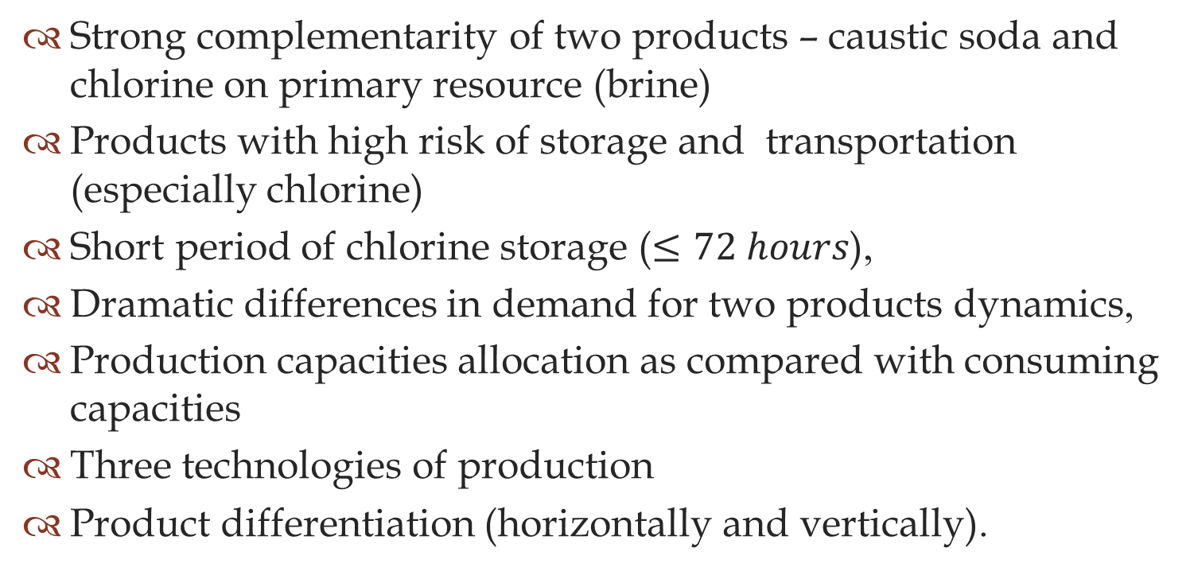
«Caustic soda 2011-…»: important dimensions to take into account
Strong complementarity of two products – caustic soda and chlorine on primary resource (brine)
Products with high risk of storage and transportation (especially chlorine)
Short period of chlorine storage ($≤72 hours$),
Dramatic differences in demand for two products dynamics,
Production capacities allocation as compared with consuming capacities
Three technologies of production
Product differentiation (horizontally and vertically).

Slide 22
Conclusions, recommendations …
Do not confuse cartel effects with economics of cartels as an agreement
Cartel investigation have to provide evidence in the following aspects
  Cartel markers (as a condition for case opening but not sufficient proof)
  Understanding of contracting in the industry
  Identification of economic meaning of the agreement
  Description and explanation of enforcement mechanism both on the side of coercion and adaptation

Slide 23
…and Questions
  When cartel case investigation is actually finished?
  What is appropriate to discuss while cartel case is not closed?
  What is real status of cartel cases in courts as regards innocence presumption?
  How answers on questions above do influence on cartel investigation effectiveness, in particular, and cartel deterrence, in general?

Slide 24
Thank you! www.lccp.econ.msu.ru

